Slide 1
Predator-prey systems
Group: Amalia Bogri, Christian Berrig & Jonas Bolduan

Slide 2
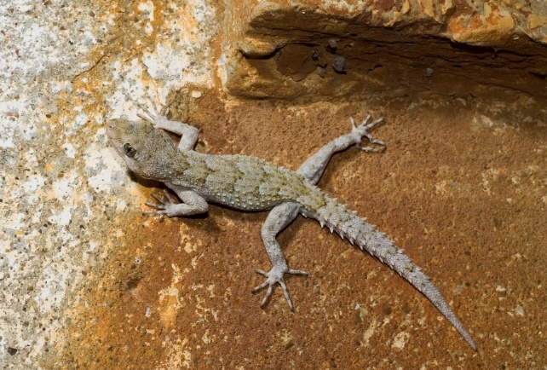
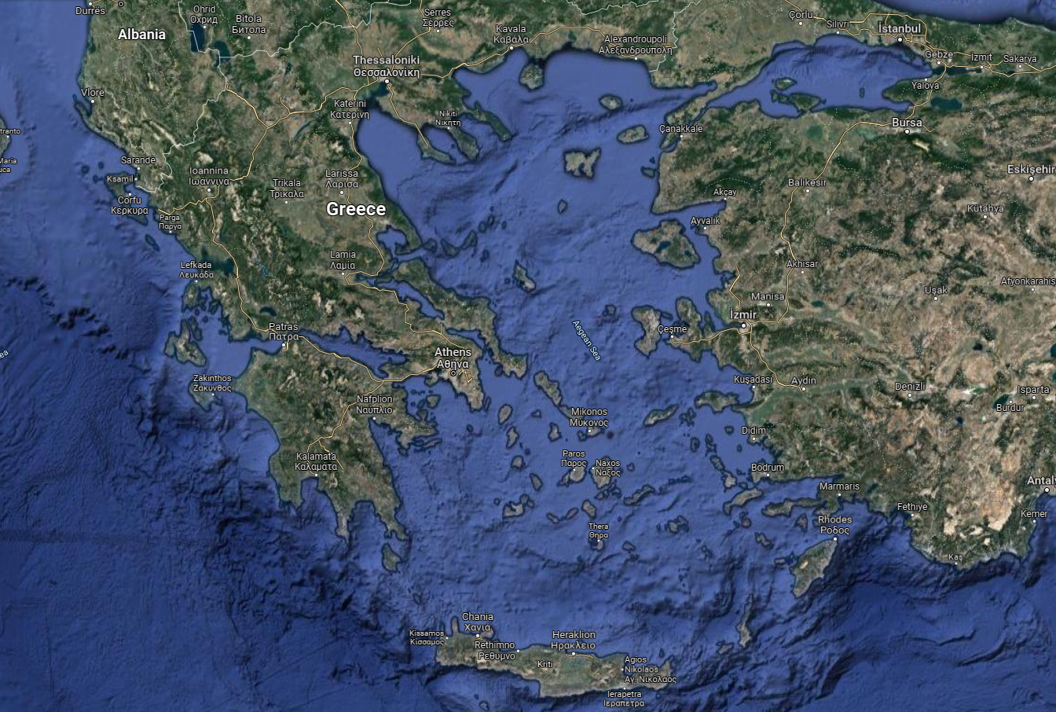
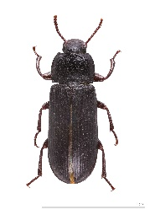
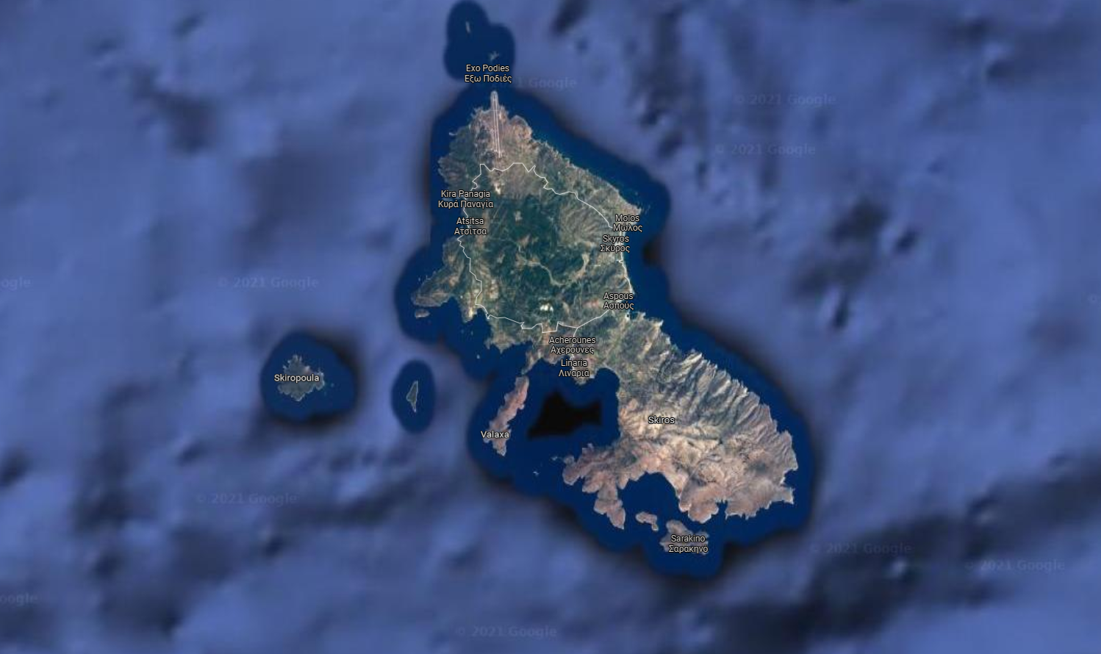
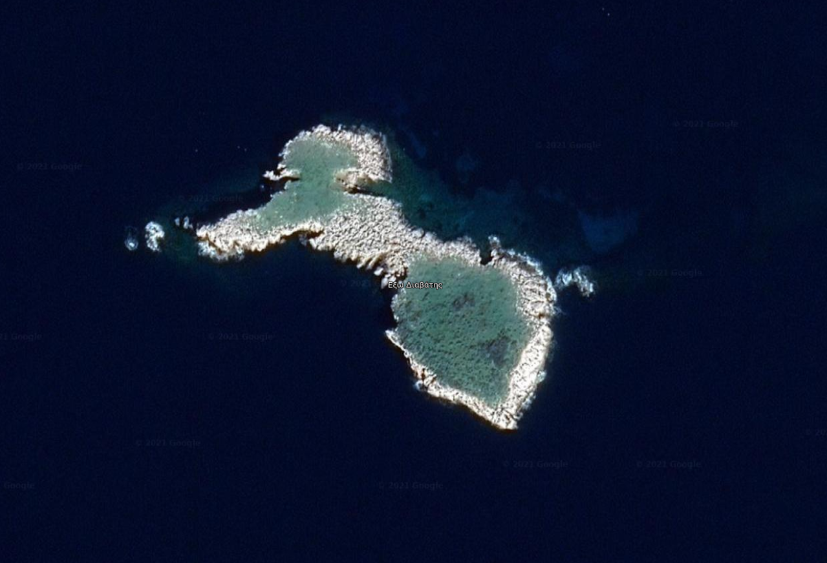
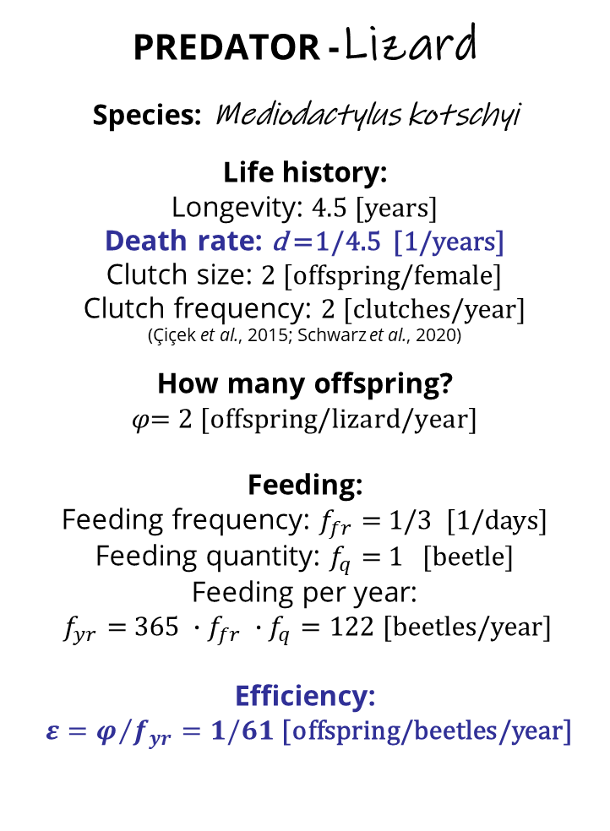
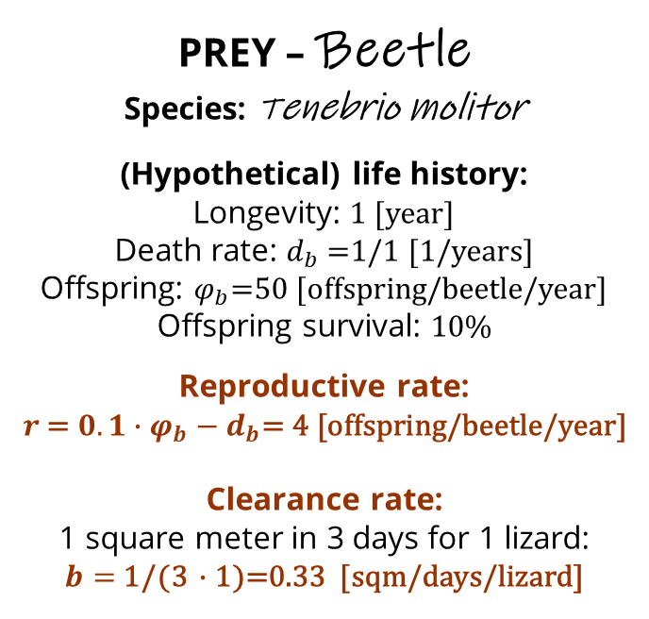
The case: insular geckos on an Aegean islet
LOCATION:
Exo Diavates, V = 20 [sqm]
PREDATOR -Lizard
Species: Mediodactylus kotschyi
Life history:
Longevity: 4.5 [years]
Death rate: d =1/4.5 [1/years]
Clutch size: 2 [offspring/female]
Clutch frequency: 2 [clutches/year]
(Çiçek et al., 2015; Schwarz et al., 2020)
How many offspring?
$$φ\text{= }\text{2 [}\text{offspring}\text{/}\text{lizard}\text{/}\text{year}\text{]}$$
Feeding:
Feeding frequency: $f_{fr}=$ 1/3 [1/days]
Feeding quantity: $f_{q}=$ 1 [beetle]
Feeding per year:
$f_{yr}=$ ${{365 ∙f}_{fr} ∙f}_{q}=122$[beetles/year]
Efficiency:
${ε=φ}/{f_{yr}}=1/61$ [offspring/beetles/year]
PREY – Beetle
Species: Tenebrio molitor
(Hypothetical) life history:
Longevity: 1 [year]
Death rate: $d_{b}$=1/1 [1/years]
Offspring: $φ_{b}$=50 [offspring/beetle/year]
Offspring survival: 10%
Reproductive rate:
$$r \text{=}{ 0.1∙φ}_{b}−d_{b}\text{= 4}\text{ [}\text{offspring}\text{/}\text{beetle}\text{/}\text{year}\text{]}$$
Clearance rate:
1 square meter in 3 days for 1 lizard:
$b=$ 1/(3 $∙$1)=0.33 [sqm/days/lizard]
© Benny Trapp,
CC BY 3.0
<https://creativecommons.org/licenses/by/3.0>,
via Wikimedia Commons

Slide 3
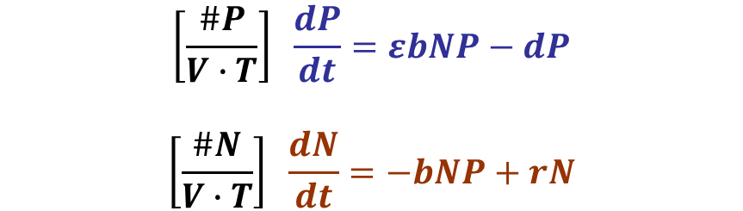
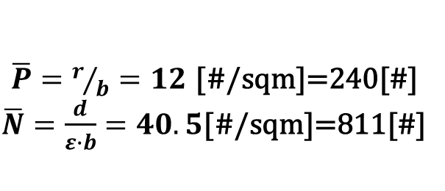
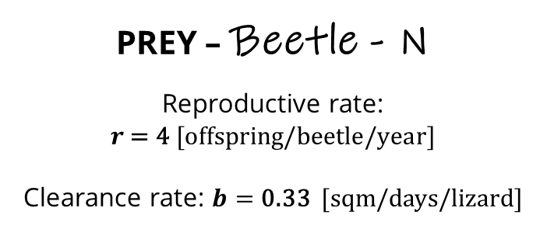
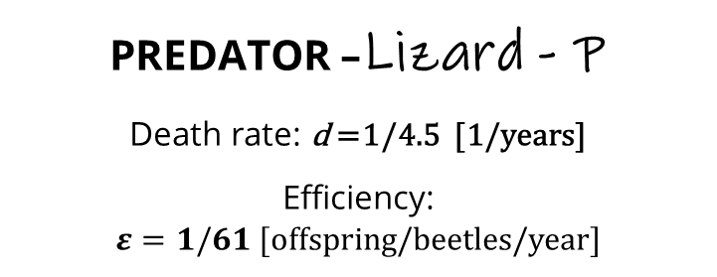
Lotka-Volterra Predator-Prey equations
PREDATOR –Lizard - P
Death rate: d =1/4.5 [1/years]
Efficiency:
$ε=1/61$ [offspring/beetles/year]
bNP
N
P
times ε
𝑑P
r
PREY – Beetle - N
Reproductive rate:
$$r \text{= 4} \text{[}\text{offspring}\text{/}\text{beetle}\text{/}\text{year}\text{]}$$
Clearance rate: $b=$ 0.33 [sqm/days/lizard]
units
equations
equilibria
$$\left[\frac{\#P}{V∙T}\right] \frac{dP}{dt}=εbNP−dP$$
$$\left[\frac{\#N}{V∙T}\right] \frac{dN}{dt}=−bNP+rN$$
© Benny Trapp,
CC BY 3.0
<https://creativecommons.org/licenses/by/3.0>,
via Wikimedia Commons
$\overline{P}=r/b=12$ [#/sqm]=240[#]
$\overline{N}=\frac{d}{ε∙b}=40.5$[#/sqm]=811[#]
3

Slide 4
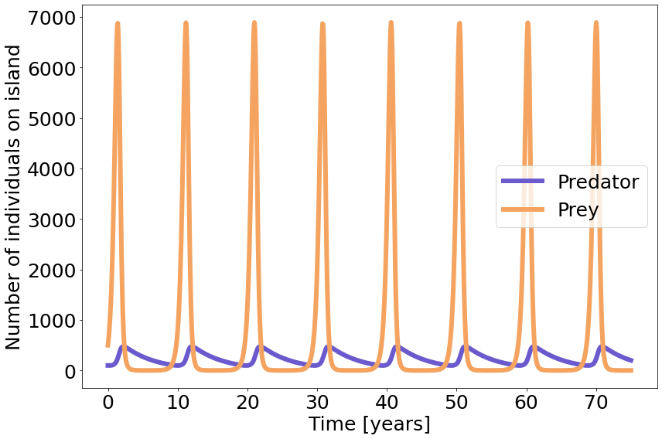
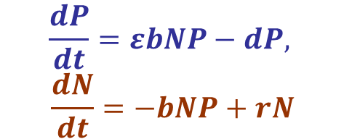
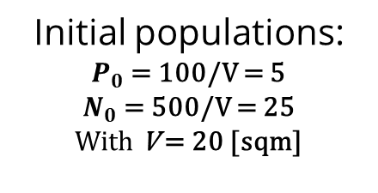
Lotka-Volterra Predator-Prey, plot in time (75 years)
Initial populations:
$P_{0}$ = 100/V = 5
$N_{0}$ = 500/V = 25
With V = 20 [sqm]
6892
$$\frac{dP}{dt}=εbNP−dP,$$
$$\frac{dN}{dt}=−bNP+rN$$
99
475
1
Populations of beetles and lizards oscillate every, approximately,
10 years.
© Benny Trapp,
CC BY 3.0
<https://creativecommons.org/licenses/by/3.0>,
via Wikimedia Commons
4

Slide 5
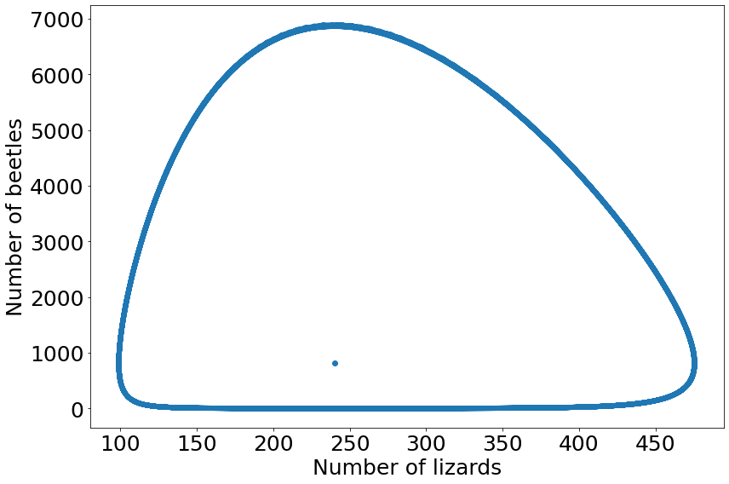
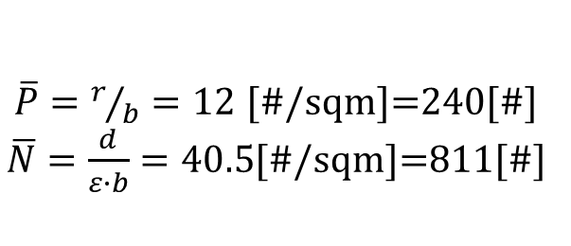
Lotka-Volterra Predator-Prey, phase plane plot
Initial populations:
$P_{0}$ = 100/V = 5
$N_{0}$ = 500/V = 25
With V = 20 [sqm]
$$\frac{dP}{dt}=εbNP−dP,$$
$$\frac{dN}{dt}=−bNP+rN$$
The populations never reach the equilibrium.
$\overline{P}=r/b=12$ [#/sqm]=240[#]
$\overline{N}=\frac{d}{ε∙b}=40.5$[#/sqm]=811[#]
© Benny Trapp,
CC BY 3.0
<https://creativecommons.org/licenses/by/3.0>,
via Wikimedia Commons

Slide 6
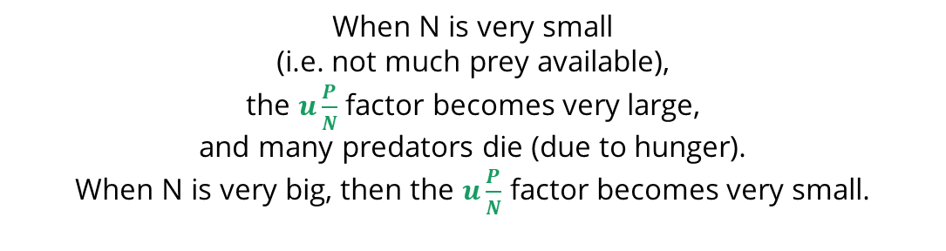
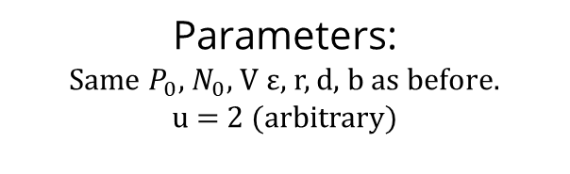
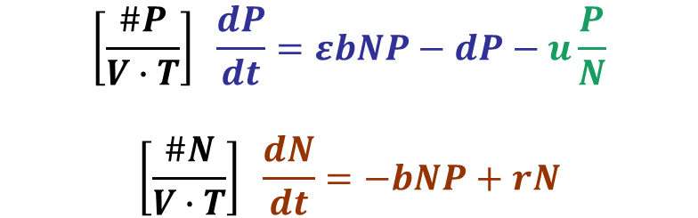
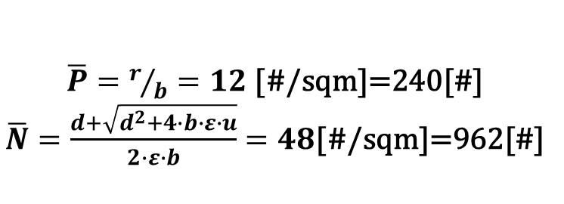
Lotka-Volterra Predator-Prey: Mortality due to hunger
Parameters:
Same $P_{0}$, $N_{0}$, V ε, r, d, b as before.
u = 2 (arbitrary)
εbNP
N
P
units
equations
$$\left[\frac{\#P}{V∙T}\right] \frac{dP}{dt}=εbNP−dP−u\frac{P}{N}$$
$$\left[\frac{\#N}{V∙T}\right] \frac{dN}{dt}=−bNP+rN$$
𝑑P
r
uP/N
equilibria
When N is very small (i.e. not much prey available), the $u\frac{P}{N}$ factor becomes very large, and many predators die (due to hunger). When N is very big, then the $u\frac{P}{N}$ factor becomes very small.
© Benny Trapp,
CC BY 3.0
<https://creativecommons.org/licenses/by/3.0>,
via Wikimedia Commons
$\overline{P}=r/b=12$ [#/sqm]=240[#]
$\overline{N}=\frac{d+\sqrt{d^{2}+4∙b∙ε∙u}}{2∙ε∙b}=48$[#/sqm]=962[#]

Slide 7
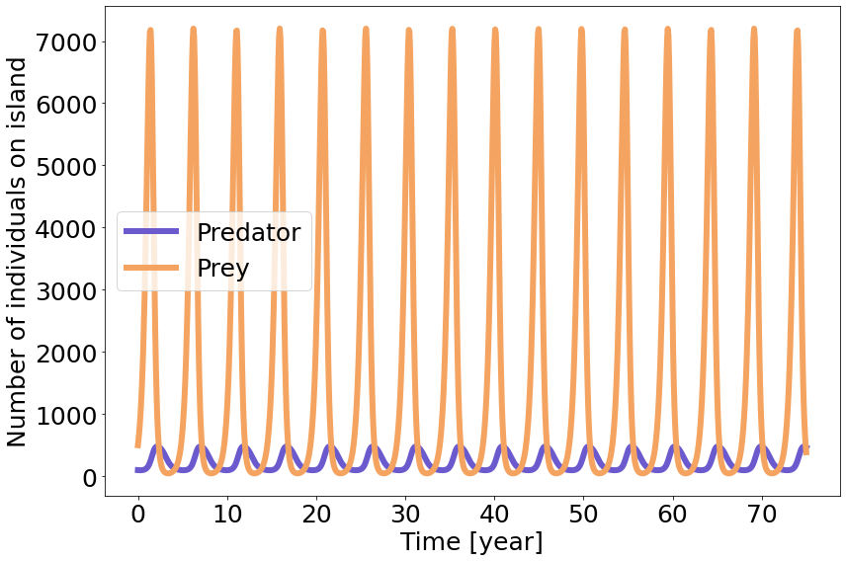
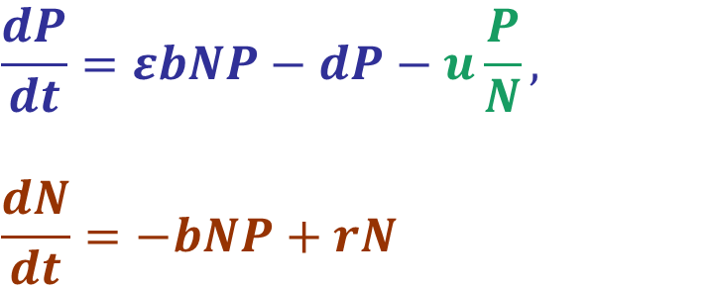
Lotka-Volterra Predator-Prey: Mortality due to hunger
$$\frac{dP}{dt}=εbNP−dP−u\frac{P}{N},$$
$$\frac{dN}{dt}=−bNP+rN$$
Populations of beetles and lizards oscillate every, approximately,
5 years.
This is because predators die faster when there is little prey.
Then, prey gets the change to recover also faster (compared to the first case). So, the system oscillates more often than without the hunger factor.
© Benny Trapp,
CC BY 3.0
<https://creativecommons.org/licenses/by/3.0>,
via Wikimedia Commons

Slide 8
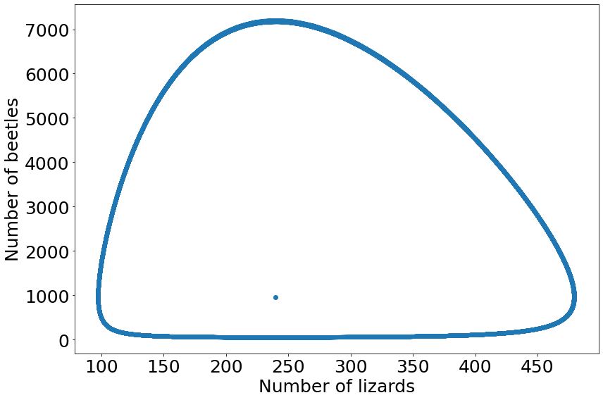
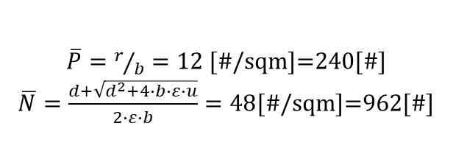
Lotka-Volterra Predator-Prey: Mortality due to hunger
$$\frac{dP}{dt}=εbNP−dP−u\frac{P}{N},$$
$$\frac{dN}{dt}=−bNP+rN$$
The populations never reach the equilibrium.
$\overline{P}=r/b=12$ [#/sqm]=240[#]
$\overline{N}=\frac{d+\sqrt{d^{2}+4∙b∙ε∙u}}{2∙ε∙b}=48$[#/sqm]=962[#]
© Benny Trapp,
CC BY 3.0
<https://creativecommons.org/licenses/by/3.0>,
via Wikimedia Commons

Slide 9
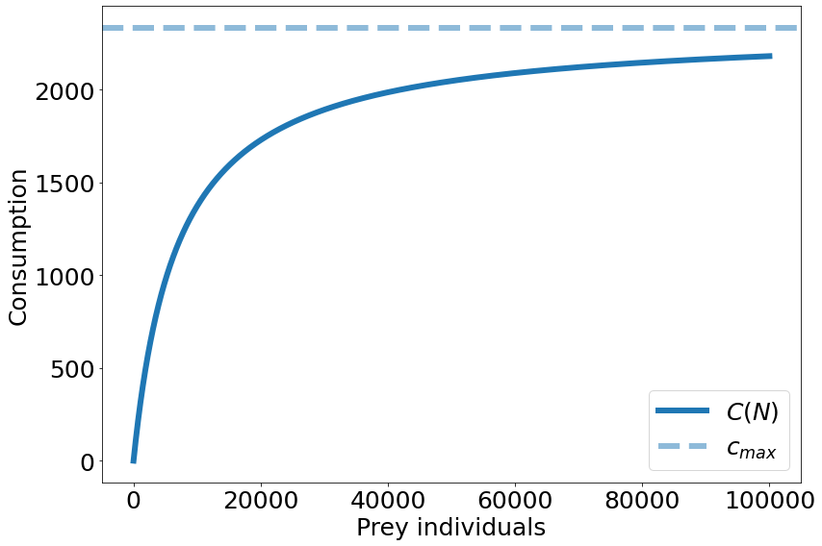
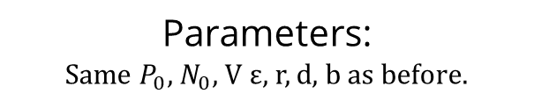
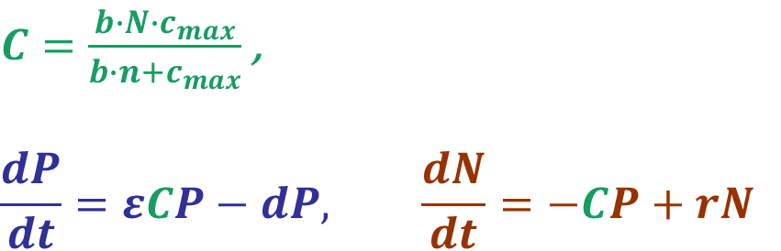
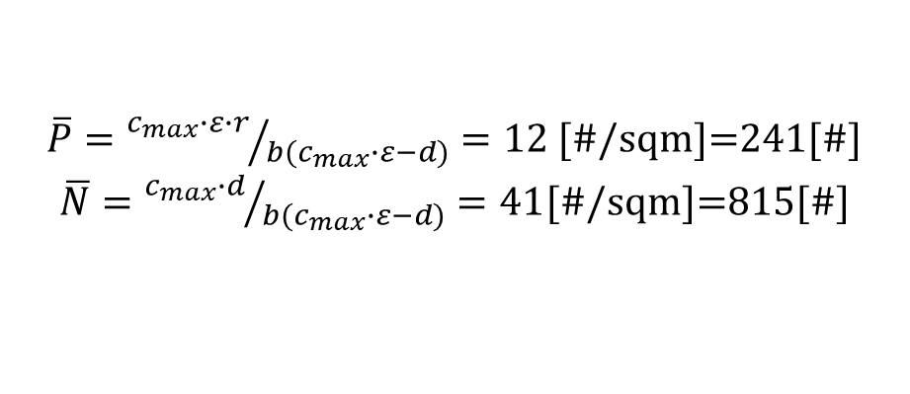
Lotka-Volterra Predator-Prey: Type II functional response
Parameters:
Same $P_{0}$, $N_{0}$, V ε, r, d, b as before.
εCP
N
P
r
𝑑P
$C=\frac{b∙N∙c_{max}}{b∙n+c_{max}}$ ,
$$\frac{dP}{dt}=εCP−dP, \frac{dN}{dt}=−CP+rN$$
equations
When N is very small, consumption c approaches bN.
When N is very large, consumption approaches Cmax.
equilibria
© Benny Trapp,
CC BY 3.0
<https://creativecommons.org/licenses/by/3.0>,
via Wikimedia Commons
$\overline{P}={c_{max}∙ε∙r}/{b(c_{max}∙ε−d)}=12$ [#/sqm]=241[#]
$\overline{N}={c_{max}∙d}/{b(c_{max}∙ε−d)}=41$[#/sqm]=815[#]
9

Slide 10
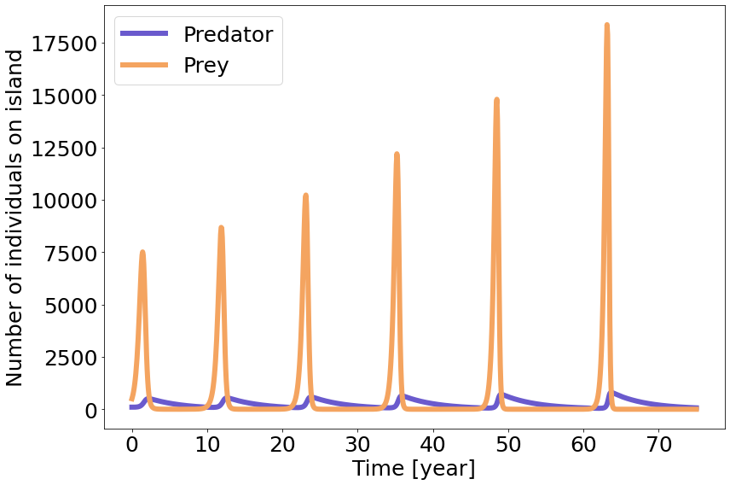
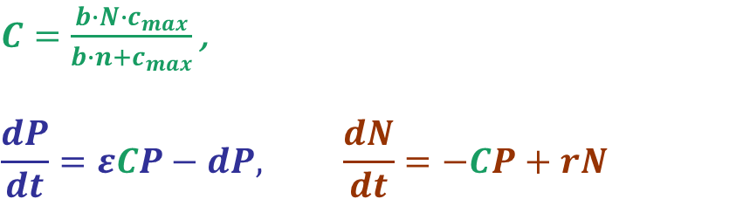
Lotka-Volterra Predator-Prey: Type II functional response
$C=\frac{b∙N∙c_{max}}{b∙n+c_{max}}$ ,
$$\frac{dP}{dt}=εCP−dP, \frac{dN}{dt}=−CP+rN$$
Populations of beetles and lizards oscillate every, approximately,10 years.
Because the predators are satiated at Cmax, the prey has a chance to recover to larger numbers.
Then, at the next cycle, the higher prey numbers can support more predators.
Yet again, because they are satiated, the prey can recover to even higher numbers
© Benny Trapp,
CC BY 3.0
<https://creativecommons.org/licenses/by/3.0>,
via Wikimedia Commons
10

Slide 11
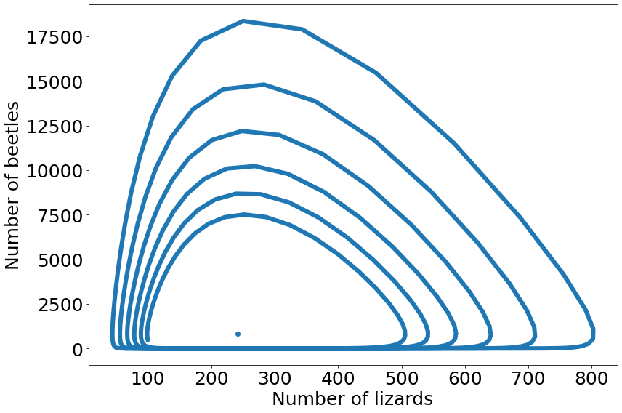
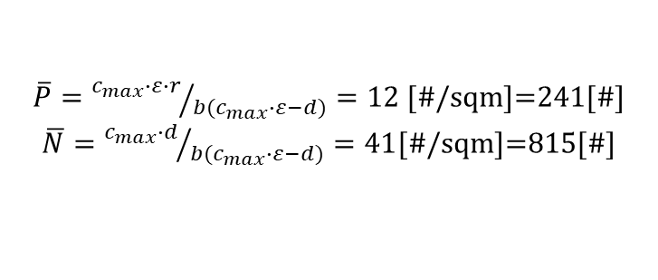
Lotka-Volterra Predator-Prey: Type II functional response
$C=\frac{b∙N∙c_{max}}{b∙n+c_{max}}$ ,
$$\frac{dP}{dt}=εCP−dP, \frac{dN}{dt}=−CP+rN$$
The populations never reach the equilibrium, but the curve of the phase plane plot keeps expanding with time (to higher respective numbers of predators and prey) .
© Benny Trapp,
CC BY 3.0
<https://creativecommons.org/licenses/by/3.0>,
via Wikimedia Commons
$\overline{P}={c_{max}∙ε∙r}/{b(c_{max}∙ε−d)}=12$ [#/sqm]=241[#]
$\overline{N}={c_{max}∙d}/{b(c_{max}∙ε−d)}=41$[#/sqm]=815[#]
11

Slide 12
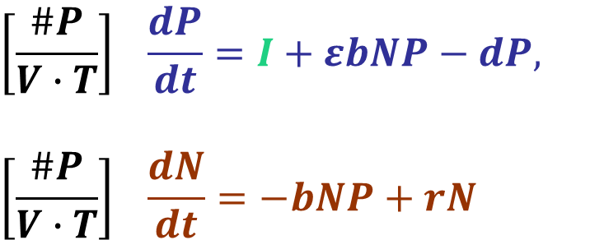
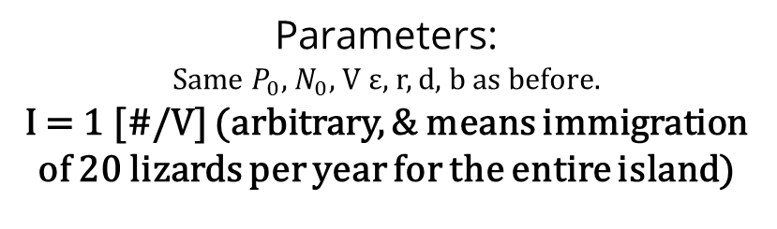
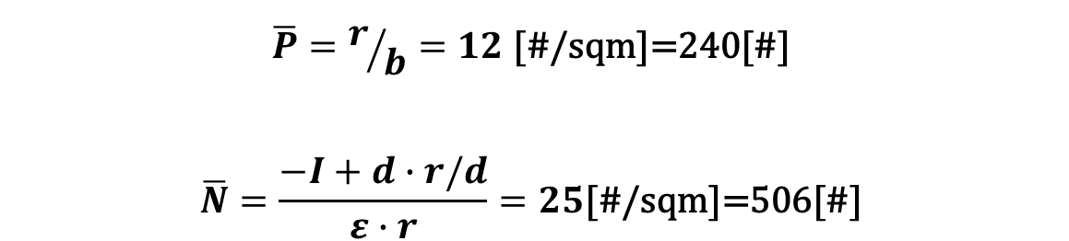
Lotka-Volterra Predator-Prey: Immigration of predators
Parameters:
Same $P_{0}$, $N_{0}$, V ε, r, d, b as before.
I = 1 [#/V] (arbitrary, & means immigration of 20 lizards per year for the entire island)
I
εbNP
N
P
units
equations
𝑑P
$$\left[\frac{\#P}{V∙T}\right] \frac{dP}{dt}=I+εbNP−dP,$$
$$\left[\frac{\#P}{V∙T}\right] \frac{dN}{dt}=−bNP+rN$$
r
equilibria
$$\overline{P}=r/b=12\text{ [\#/}\text{sqm}\text{]=}\text{24}\text{0}\text{[\#]}$$
$$\overline{N}=\frac{−I+d∙r/d}{ε∙r}=25\text{[\#/}\text{sqm}\text{]=}\text{506}\text{[\#]}$$
© Benny Trapp,
CC BY 3.0
<https://creativecommons.org/licenses/by/3.0>,
via Wikimedia Commons
12

Slide 13
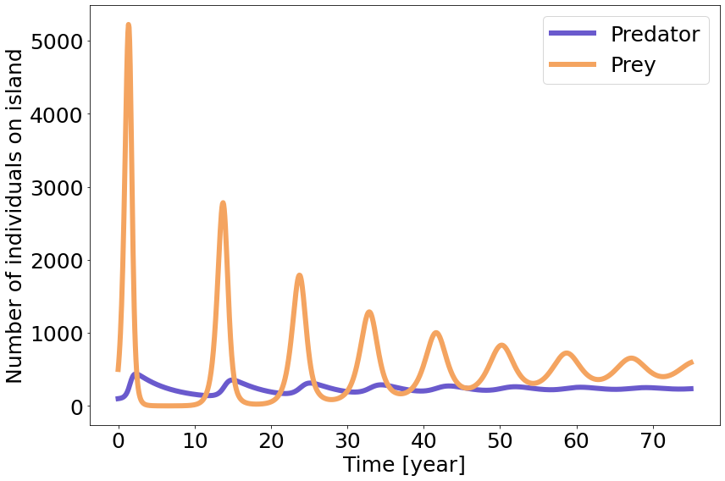
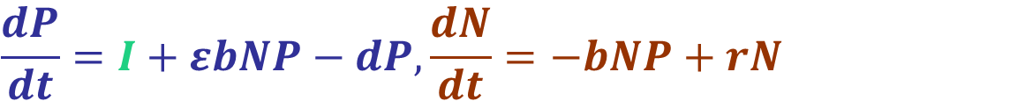
Lotka-Volterra Predator-Prey: Immigration of predators
$$\frac{dP}{dt}=I+εbNP−dP, \frac{dN}{dt}=−bNP+rN$$
Populations of beetles and lizards oscillate every, approximately, 10 years, with the cycles becoming shorter and shorter in time.
The oscillations also become less acute.
Because of the constant immigration of predators, prey recovers to smaller total population number every cycle.
This prey population can support less predators, which makes the oscillations shorter in time.
Yet the constant predator immigration leads to the decreasing the number of prey in the next cycles.
© Benny Trapp,
CC BY 3.0
<https://creativecommons.org/licenses/by/3.0>,
via Wikimedia Commons
13

Slide 14
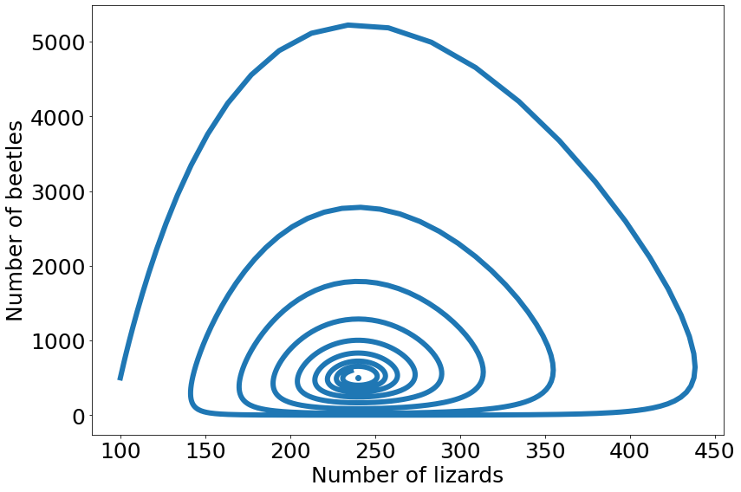
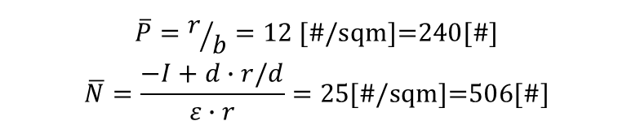
Lotka-Volterra Predator-Prey: Immigration of predators
$$\frac{dP}{dt}=I+εbNP−dP, \frac{dN}{dt}=−bNP+rN$$
The populations do not reach equilibrium in 75 years,
but have the potential to reach it
(if we would run the simulation for a longer period of time).
$$\overline{P}=r/b=12\text{ [\#/}\text{sqm}\text{]=}\text{24}\text{0}\text{[\#]}$$
$$\overline{N}=\frac{−I+d∙r/d}{ε∙r}=25\text{[\#/}\text{sqm}\text{]=}\text{506}\text{[\#]}$$
© Benny Trapp,
CC BY 3.0
<https://creativecommons.org/licenses/by/3.0>,
via Wikimedia Commons
14

